Slide 1
Mini Project Seminar on Team Travel Planning Tool

Slide 2
Student Reg : KUB23CSE027
Name of student : Bindu Patil
Name of Institution : Kishkinda University
Department Name : Computer Science
Year of Study : 2024
Submission date : 28-09-2024

Slide 3
Description:
Introduction
Objectives
Methodology
Results/Findings
Conclusions
References

Slide 4

Introduction:
Travel planning for team whether for corporate events, conferences, or group excursions can be a complex and time-consuming task.
Coordinating schedules, booking flights, managing accommodations, and ensuring that everyone's needs are met requires a tool that can simplify and streamline the process.

Slide 5
The Team Travel Planning Tool is designed to address these challenges by providing a centralized platform for organizing and managing team travel efficiently.
It help to tackle specific problems such as car parking pressures or road safety issues.
It capture itinerary information and implement robust risk management measures.

Slide 6
Objective:
Enhance Collaboration :
Enable real-time collaboration among team members by allowing them to contribute to the travel plan, share preferences, and suggest modifications, ensuring the itinerary suits everyone’s needs.
Optimize Time and Resource Management :
Minimize the time spent on booking, organizing, and managing travel plans by automating key processes like flight and hotel reservations, reducing the administrative burden on team leaders or travel coordinators.

Slide 7
Streamlined Itinerary Creation :
Easily plan and organize a complete travel itinerary, including flights, accommodation, and activities.
Collaboration and Communication :
Enable team members to collaborate, suggest changes, and communicate regarding trip details in real-time.
Budget Management :
Track travel expenses, set budgets, and ensure that the trip remains cost-effective.

Slide 8
Travel Approvals and Permission :
Facilitate approvals from managers or relevant stakeholders for travel plans, accommodations, and expenses.
Centralized Information :
Provide a centralized platform for storing travel documents, tickets, confirmations, and emergency contacts.
Task Assignment and Delegation :
Assign roles and responsibilities to different team members (e.g., booking flights, reserving hotels.

Slide 9
Methodology:
Agile Methodology :
Agile can be used to manage the development process. Teams work in iterative cycles (sprints) to build features incrementally.
Scrum or Kanban boards to manage tasks and keep track of project progress.

Slide 10
Tools for Project Management and Collaboration :
Trello, Jira, or Asana: For tracking features, tasks, bugs, and user stories.
Slack or Microsoft Teams: For team communication and collaboration during the development and testing phases.
Confluence: For maintaining documentation related to the project.

Slide 11
Software Development Programming Languages:
Depending on the platform (web or mobile):Java Script/ TypeScript: For web-based applications (React, Angular, Vue.js).
Swift (iOS) and Kotlin (Android) for mobile app development.
Python or Node.js for server-side logic and backend processes.

Slide 12
Results/Finding:
Increased Efficiency:
Teams report reduced time spent on travel logistics due to streamlined planning processes.
Enhanced Communication:
Improved coordination among team members leads to fewer misunderstandings and last-minute changes.

Slide 13
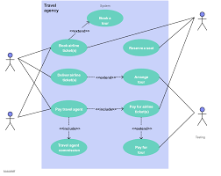
Travel Agency

Slide 14
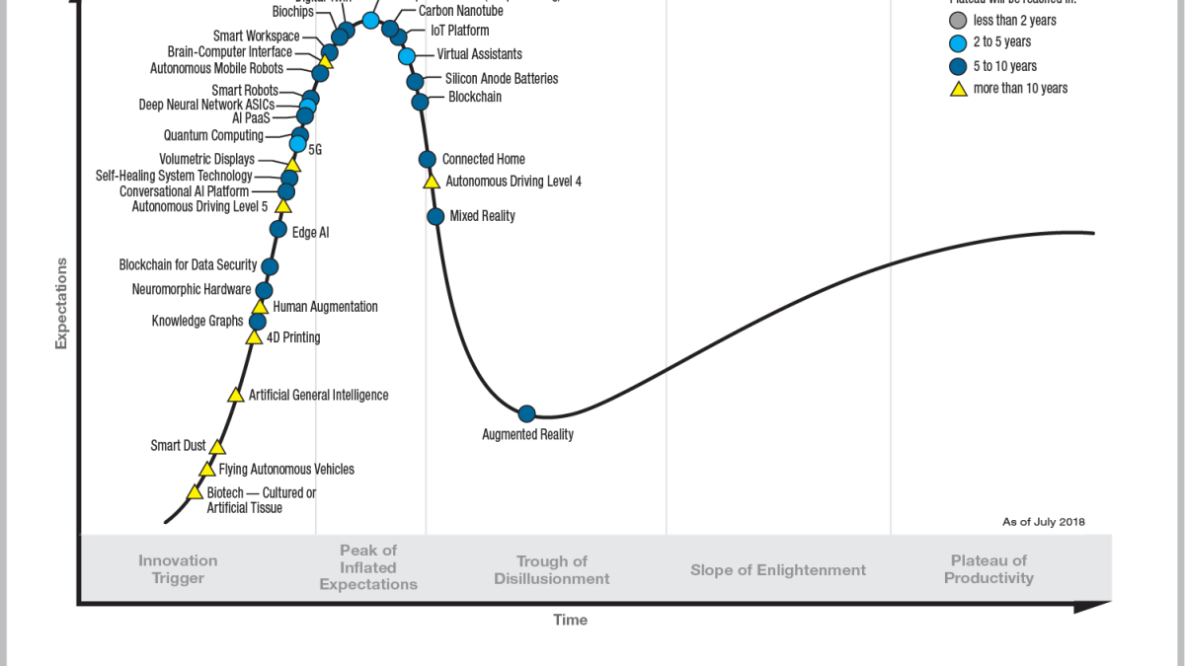

Slide 15
Concur: Expense management software that includes travel planning features.
Website: https://concur.com
Kayak for Business: A travel management tool designed for teams.
Website: kayak.com/business

Slide 16
Books:
"The Business Travel Handbook" by Michael F. Smith: Offers insights into efficient travel planning and management.
"Travel Management: A Handbook for Travel Managers" by Alana D. Mohr: Discusses best practices for corporate travel.
"Corporate Travel Management" by Eric S. Turner: Covers strategies for optimizing business travel.

Slide 17
Conclusion :
the team travel planning tool offers a streamlined solution for organizing group travel, ensuring efficiency, and minimizing logistical challenges.
By centralizing booking, scheduling, and expense tracking, the tool enhances coordination among team members, reduces time spent on manual tasks, and provides valuable data insights for optimizing future trips.

Slide 18
Reference:
Online Tools:
TripIt : An itinerary management tool that organizes travel plans in one place.
Website : tripit.com
TravelPerk : A comprehensive travel management platform for businesses.
Website : travelperk.com

Slide 19
import unittest
# Assuming you have the classes Team, TravelDetail, and Expense defined in app.py
from app import Team, TravelDetail, Expense
class TestTravelPlanning(unittest.TestCase):
def setUp(self):
self.team = Team("001", "Team A")
self.travel = TravelDetail("T001", "Paris", "2024-09-01", "2024-09-10")
self.expense = Expense("E001", 100, "Accommodation", "Hotel stay in Paris")
self.team.add_travel(self.travel)
def test_add_travel(self):
self.assertIn("T001", self.team.travels)

Slide 20


